Slide 1
NE 763: Advanced Reactor Materials
Fall 2025
Dr. Benjamin Beeler

Slide 2
Last Time
Origins of void swelling resistance of F/M steels
relaxation volume of int; lower migration barrier for vac; C-vacancy BE; dislocations and solutes strong vac sinks; high density of sinks from microstructure
FeCrAl
good high T steam oxidation resistance due to formation of Al2O3 layer
balance Cr/Al content: higher is better corrosion resistance but more brittle
ferrite, thus has good swelling resistance
ODS steels
Y2O3 or Y2Ti2O7 particles dispersed to stabilize microstructure and increase sink density; increases radiation resistance and allows retention of ferrite
oxide size increases, surface energy increases, misfit strain increases
greatly improved high T creep resistance for F/M steels
oxide size and number density stable under irradiation

Slide 3
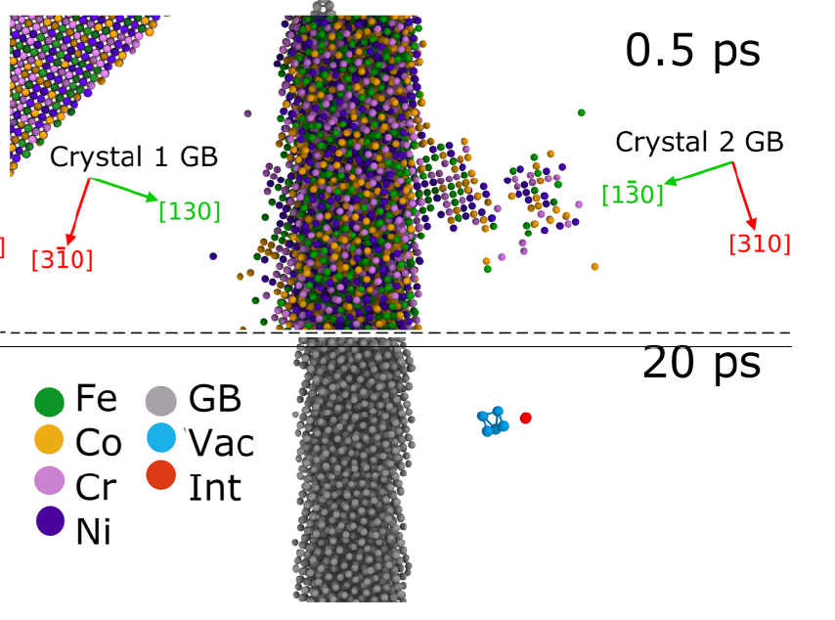
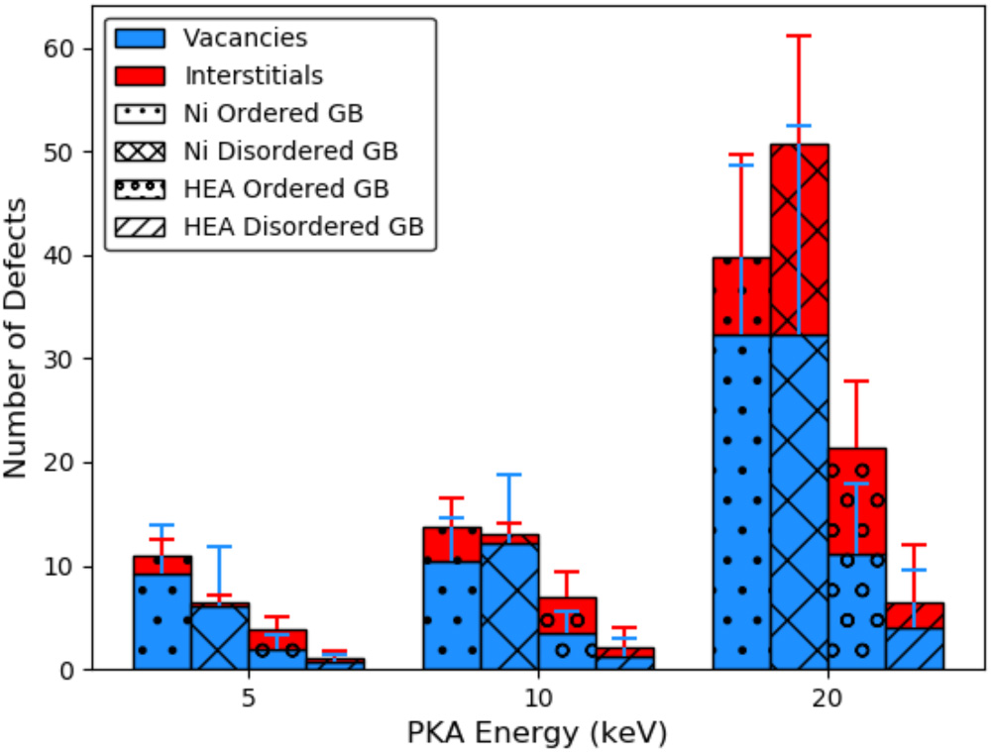
HEAs and Radiation Damage
HEAs may also be particularly suitable for high-fluence irradiation applications because of their radiation tolerance
This is related to severe lattice distortions or atomic-level stress caused by mismatches in atom size between the principal elements
This slows diffusion, prevents defect clustering, and promotes recombination
Grain boundaries are natural defect sinks and exist in all materials, but in HEAs the additional compositional complexity increases their efficiency in defect absorption

Slide 4
Notable HEAs
Most studied HEAs are either FCC or BCC based alloys
Cantor alloy: FCC CrMnFeCoNi, this is largely recognized as the first HEA, and can be stabilized as a single-phase FCC
High strength and high ductility that both increase with decreasing temperature
Fractures transgranularly through microvoids
Has been the basis for development of many HEAs, including non-equimolar HEAs with increased twinning-induced plasticity (TWIP)
BCC TiZrHfNbTa alloy
Significantly less is known on BCC HEAs
Comparable high strength to Cantor alloy (yield strength ~1 GPa), but ductility limited to 10-20%
Similar to FCC HEAs, TWIP and TRIP (transformation induced plasticity) are both active and provide ductility

Slide 5
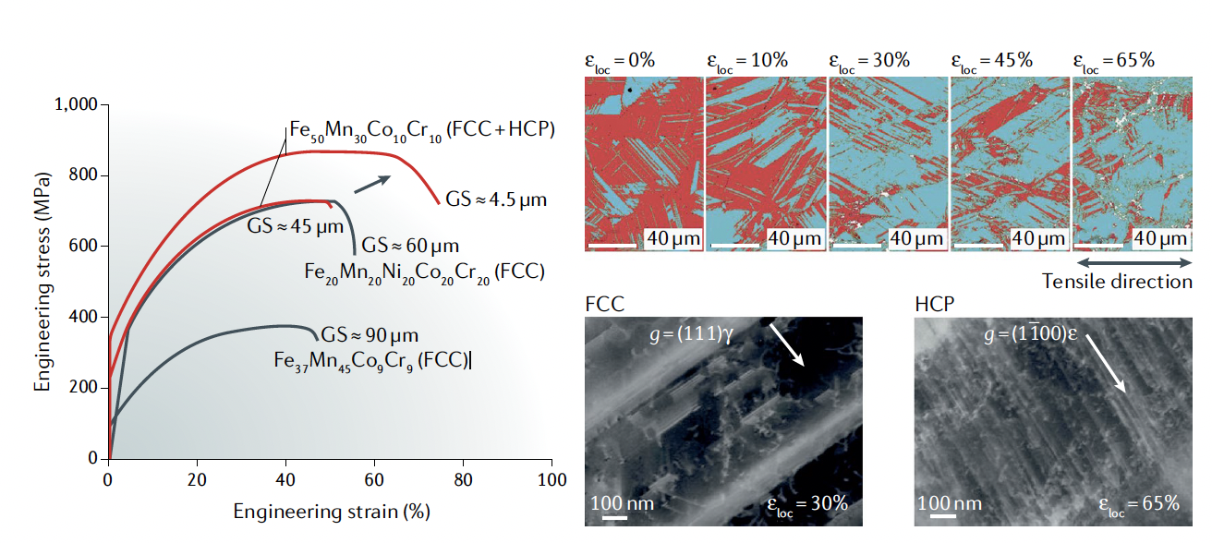
HEAs outlook
This are still very new materials (only 20 years old) and much is still poorly understood, with experimental data scattered
Data for different grain sizes can be contradictory
CALPHAD and DFT are being employed to understand the phase space and the lattice distortion effects, respectively
Fabrication is still a severe challenge, as is cold-working or forming
But… they offer unique potential for high strength, high temperature, and radiation tolerant materials
Mechanical properties of the dual- phase, high- entropy , transformation- induced plasticity alloy Fe50Mn30Co10Cr10

Slide 6
Ni alloys

Slide 7
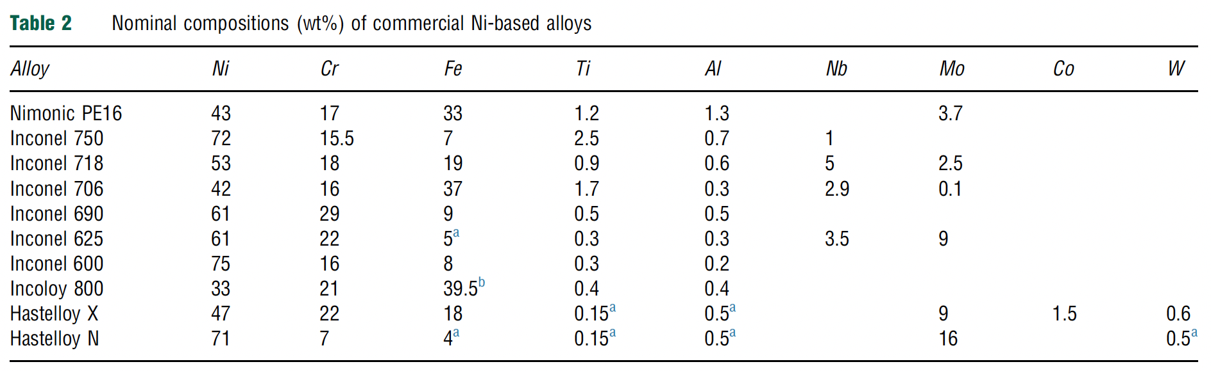
Ni Alloys
Generally resistant to corrosion and display limited mechanical property degradation at high T
Stress corrosion cracking (SCC/IASCC) is a key concern in LWR materials
He embrittlement is of major importance due to the Ni-58 neutron capture cross section which generates He
In fast reactor systems, Fe and Cr can also undergo n,alpha reactions
Ni alloys have been used in LWRs, but mainly in low-dose components, have seen some testing in fast reactors, and are of high interest in advanced reactors

Slide 8
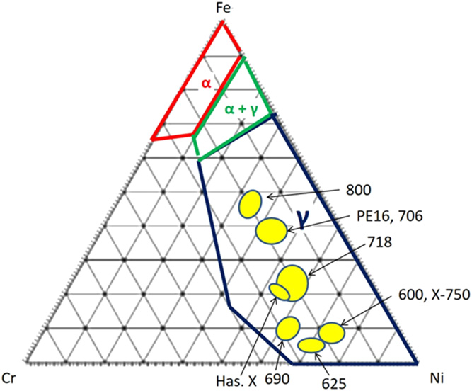
Structures
All commercial Ni alloys are gamma-phase FCC materials
Ternary phase diagram at right at 400C
Ni-alloys by rule have >28 wt% Ni
Fe and Cr are main alloy constituents, but Al, Ti, Nb, and Mo all have solubility and can be used to solid solution strengthen or precipitation harden
Most alloys are precipitation hardened to increased high temperature creep resistance

Slide 9
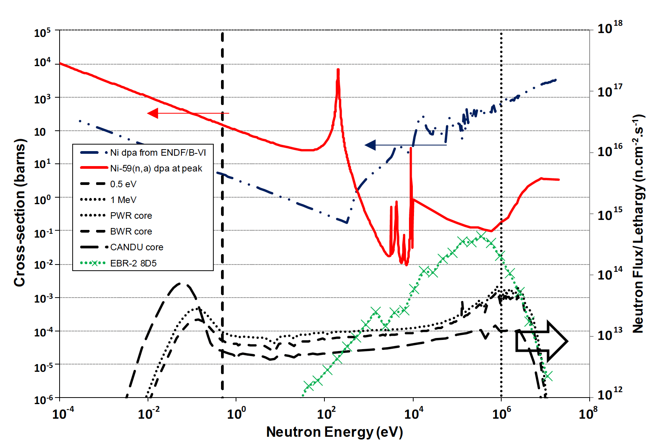
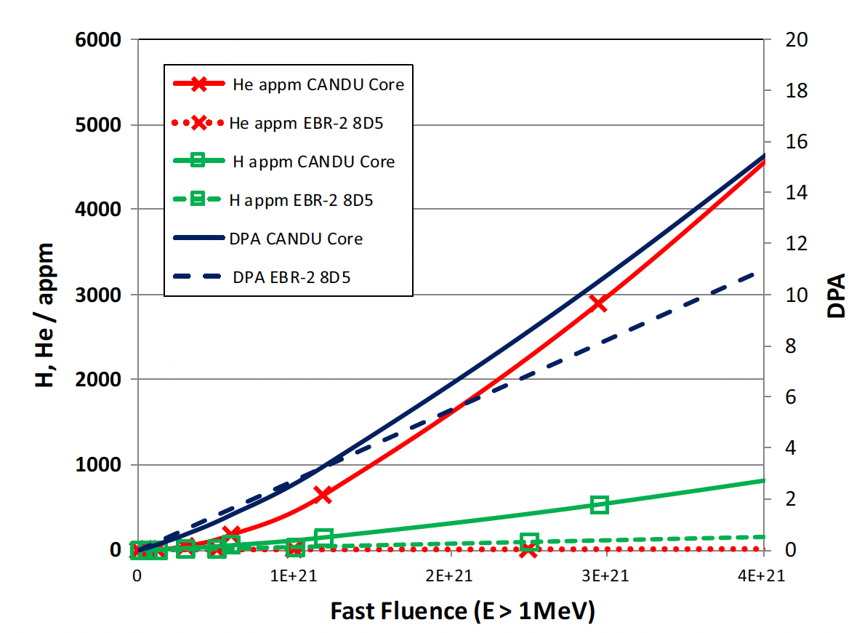
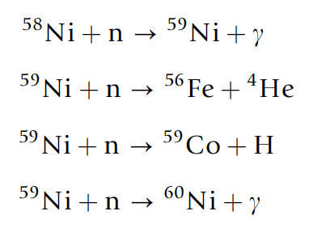
He generation
Large amounts of He and H can be produced due to high neutron dose
Ni alloys in CANDU reactors have a service lifetime of 20 years and can have >20000 appm He
The generation of He is also producing high energy PKAs which are introducing further damage into the system

Slide 10
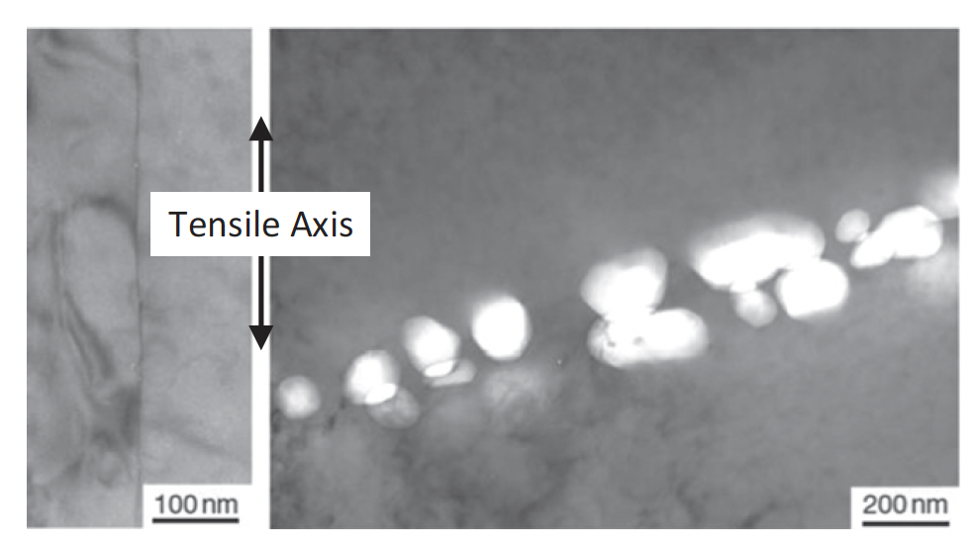
Void Swelling
The concept of void swelling is complicated by the generation of He, in that He bubbles and voids can form separately, or impact each others formation
In fast reactors, He generation is lower, about 1 appm/dpa, but He impacts on grain boundary bubbles have still been identified and are often associated with tensile stresses
Many examples that show high densities of He-stabilized grain boundary cavities in high flux reactors

Slide 11
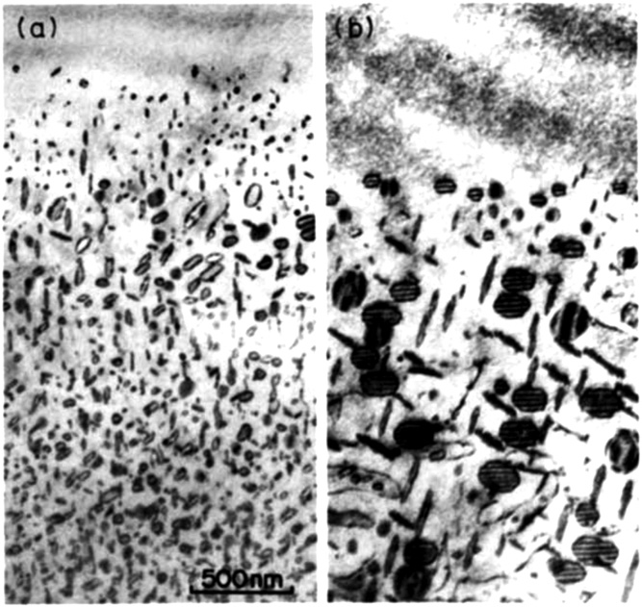
Dislocations
Large dislocation loops are observed at high temperatures expected in advanced reactors
Loop structures have been seen to be very sensitive to temperature controls during irradiation
T ramping
Constant T

Slide 12
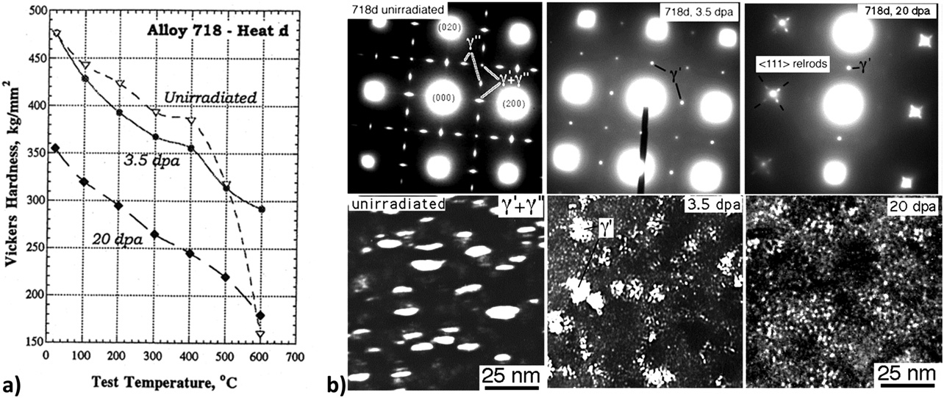
Precipitation
The primary precipitates that form are gamma’ (Ni3Al) and gamma’’ (Ni3Nb-type), where Ni can be replaced by Fe/Cr
These precipitates can be dissolved or dispersed during irradiation
There are competing ballistic and kinetic/thermodynamic factors at play
Higher temperatures allow more rapid diffusion, and the potential re-precipitation

Slide 13
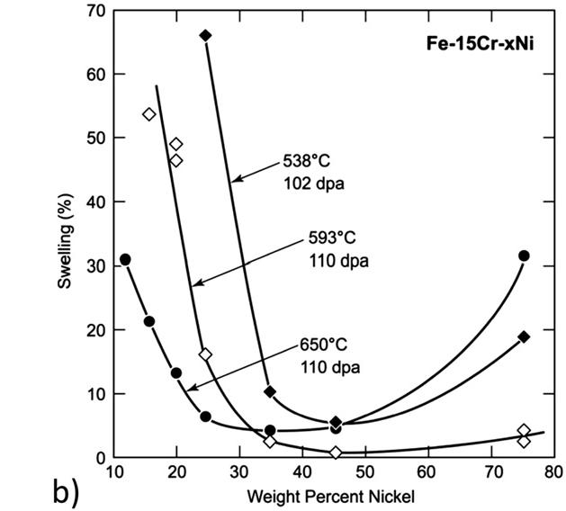
Swelling
Ni alloys generally show significantly improved resistance to swelling compared to SS
The presence of gamma’ precipitates is believed to a factor in the swelling resistance
Alloying species are expected to have the primary effect on swelling behavior, modifying local strain and vacancy biases via the inverse Kirkendall effect
neutron irradiated in a fast reactor to about 100 dpa

Slide 14
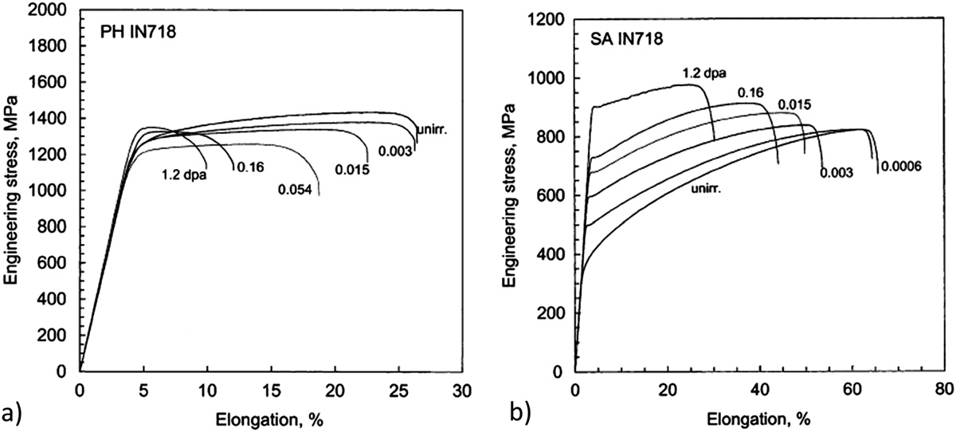
Irradiation Hardening
Ni alloys can generally be categorized into two classes: solution-annealed (SA) or precipitation hardened (PH)
The irradiation response is very different in these two classes
PH materials irradiated at low temperatures (below 100C) and low doses exhibit reduced ductility, but minimal hardening
SA materials exhibit substantial hardening in addition to a reduction in ductility

Slide 15
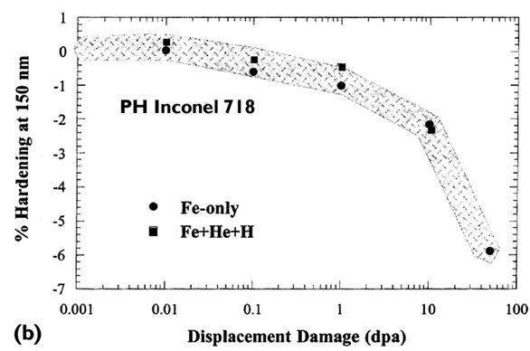
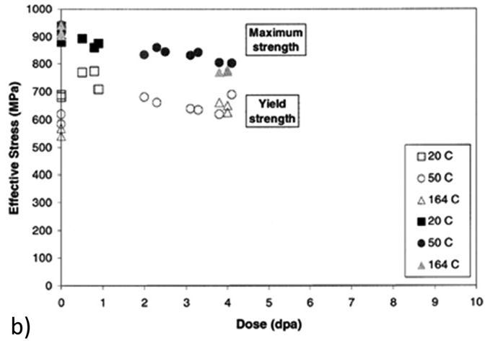
Higher Doses
For PH materials, after an initial increase in RT yield and UTS at low doses, further irradiation can result in a gradual decrease in strength
This has also been seen in PH-SS at elevated temperatures
This does not occur for SA Ni alloys
Softening due to dislocation recovery is likely the effect at high temperatures
At low T, this is likely due to precipitate dissolution

Slide 16
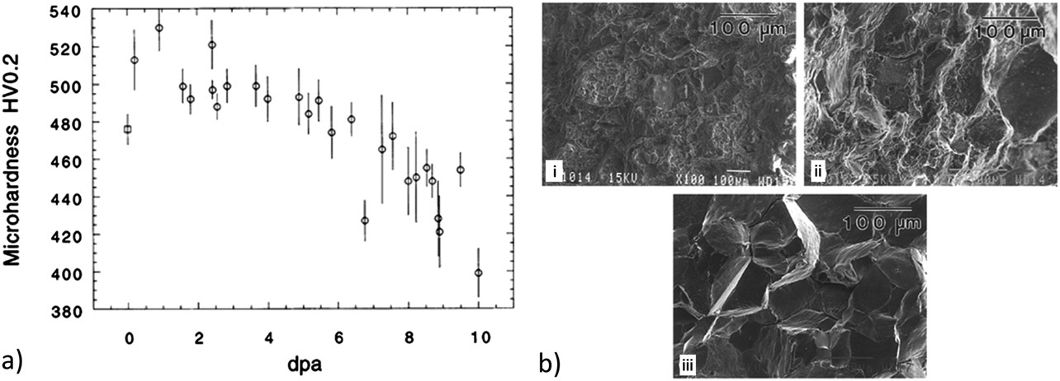
Embrittlement
Despite softening, ductility continues to decrease, embrittling the PH Ni alloy
There is a change from ductile intra-granular to brittle inter-granular failure with increasing dose at low T
This is likely related to He generation, stabilization of He grain boundary bubbles, and embrittlement
Thus, separate phenomena are leading to softening and embrittlement simultaneously
This knowledge base is built on ion irradiations, and some effects may not fully transfer to fast reactor systems

Slide 17
Ni Alloys Summary
Excellent high temperature behaviors, resistant to corrosion, reasonably compatible with molten salt, water, liquid Na
Ni transmutation is an issue which generates He, which can lead to embrittlement (bigger issue in thermal reactors)
Ni alloys are at least 28 wt% Ni, have an FCC phase, are either solid solution strengthened, or precipitation hardened (mostly PH)
gamma’ and gamma’’ precipitates provide strength, hardening, and swelling resistance
Alloys can soften with increased dose due to recovery of cold work at high T, but lose their ductility with increasing dose
Don’t have enough good data on irradiation effects in fast reactor environments

Slide 18
Research reactors

Slide 19

Intermetallic Fuels
Uranium intermetallic fuels such as U–Al, U–Si, and U–Mo are chiefly meant for research and test reactors in which neutron production, instead of power generation, is the main purpose
The operation temperatures of these fuels are much lower than those UO2
In general, the U intermetallic fuels can achieve much higher fission densities than oxide fuels
Currently available research reactor fuels are predominantly in a dispersion form that is composed of fuel particles dispersed in an inert matrix (often Al)
The fueled zone in a dispersion fuel plate (the fuel particles–matrix mixture zone) is metallurgically bonded to the Al cladding

Slide 20
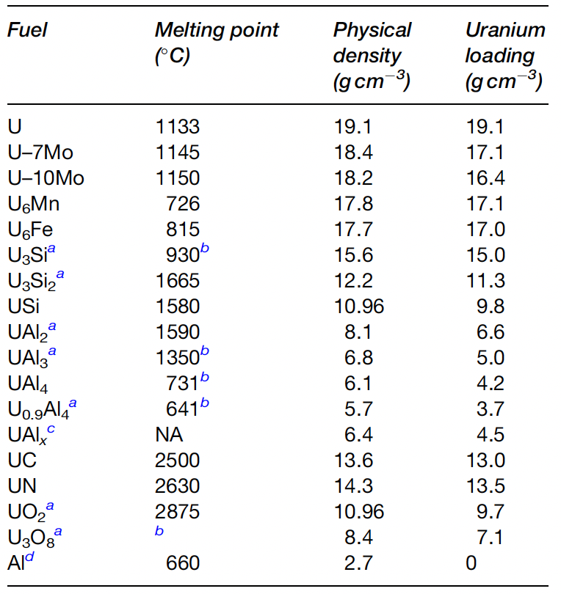
Intermetallic Fuels
U–Al, U–Si, and U–Mo fuels have been used in research reactors, with development from Al, to Si, to Mo driven by obtaining higher U densities
Uranium metal in unsuitable, so intermetallics were developed to stabilize irradiation behavior
The U-Al alloy was the first uranium intermetallic fuel chosen for research and test reactor purposes, largely because of compatibility with Al cladding

Slide 21
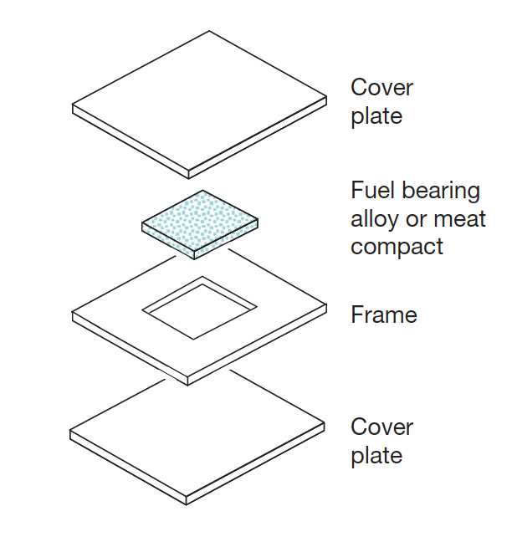
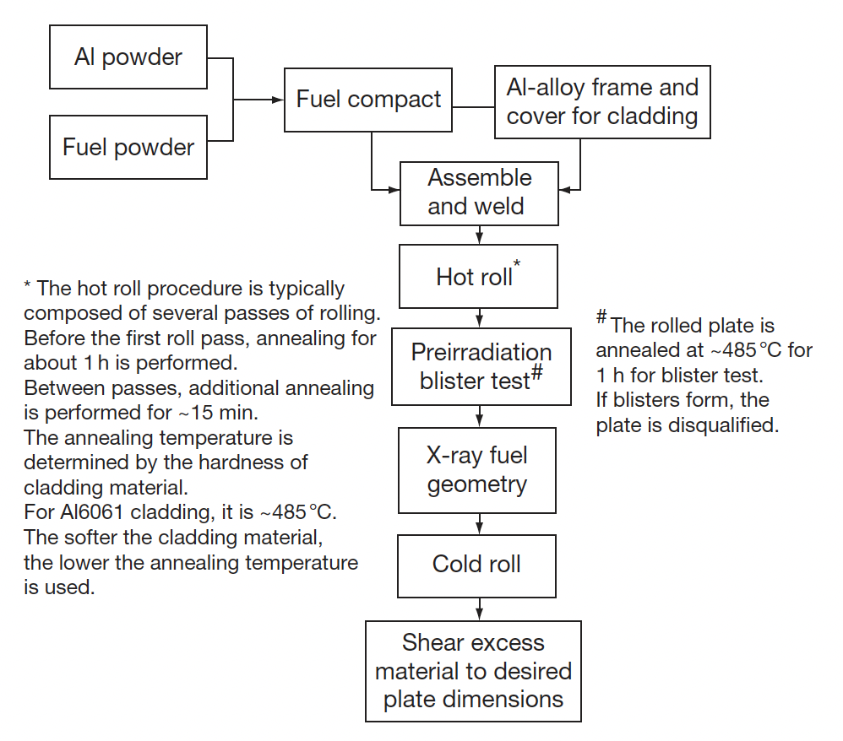
U-Al Alloys
U-Al was utilized as the fuel in the Materials Test Reactor (MTR; 1952-1970) and the Engineering Test Reactor (ETR: 1957-1981)
Fabrication of U–Al alloys with high uranium contents poses difficulties during the rolling process, and uranium inhomogeneity increases proportionally with uranium content
The application of monolithic U–Al alloy in higher power reactors was limited because of fabrication constraints and high fuel swelling

Slide 22
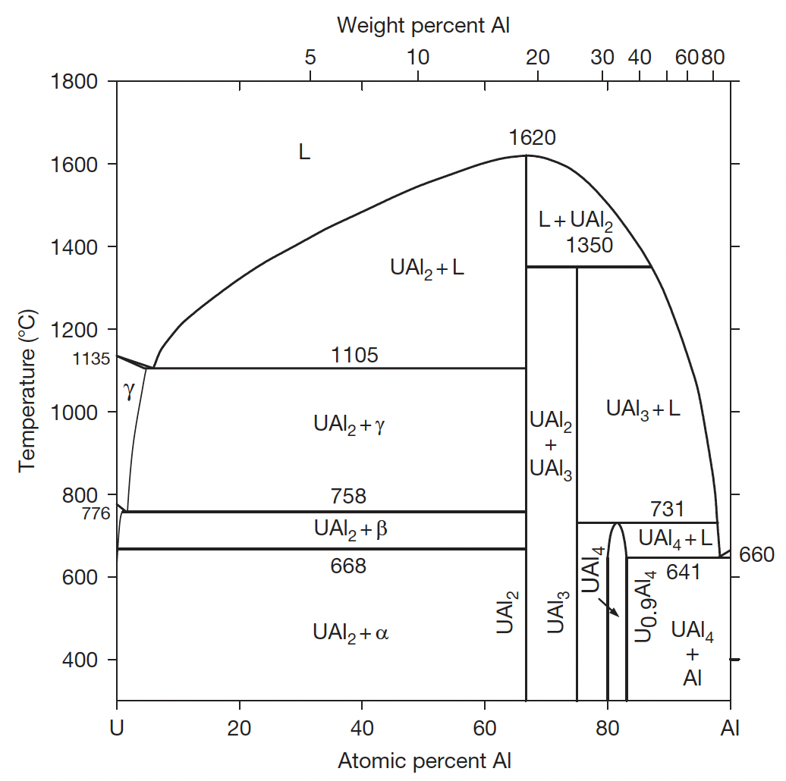
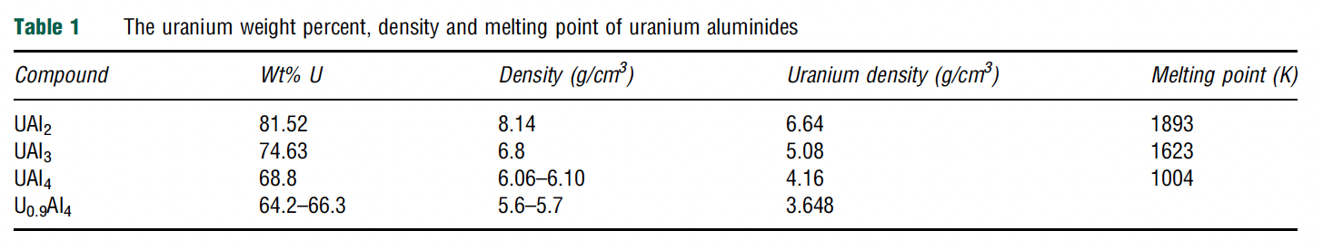
U-Al Phases
There are three intermetallic compounds in the U–Al system: UAl2, UAl3, and UAl4
UAl2 forms directly from the liquid, but UAl3 and UAl4 form by peritectoid reactions with aluminum
UAl2 is fcc, UAl3 is L1₂ type, UAl4 is bco
Densities range from 6.6 g/cc to 4.2 g/cc with decreasing U loading
Thermal conductivity of dispersion fuels is largely governed by the matrix

Slide 23
U-Al Alloys
The fuel form of U–Al alloy with a U density high enough to satisfy the need for high-power rectors is a mixture of UAl2, UAl3, and UAl4, known as UAlx
UAlx has positive features that enable its good performance in high-power reactors
Fuel swelling can be reduced by accommodating fission product swelling in the powder dispersions, which include pores left during fabrication
UAlx also has exceptional resistance to fission gas bubble formation
In addition, fabrication with a uniform distribution of burnable absorbers is possible
Typical powder lots used in the ATR contained phase fractions of 7.6 wt% UAl2, 78.6 wt% UAl3, and 13.8wt% UAl4
These phase fractions can be modified based upon the fabrication process

Slide 24
Fuel Swelling
Based on the fuel plate geometry, why is fuel swelling important?
No plenum! No Gap!

Slide 25
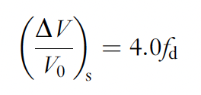
Fuel Swelling
Fuel swelling by fission products is divided into two distinct parts: solid and gaseous
Solid FP swelling is due to the difference between the volume of a uranium atom and solid fission products
Most fission gas atoms remain in the fuel, with solid FP swelling proportional only to burnup; independent of fabrication method, fuel type, temperature, etc.
Thus, solid swelling is applicable across other intermetallic fuels, with derivations from U-Zr being modified for U-Al, U-Si, and U-Mo fuels
The solid FP swelling for U-Mo is given by the above equation, where fd is fission density in 10²⁷ fissions/m³
50% burnup is approximately 4x10²⁷ f/m³

Slide 26
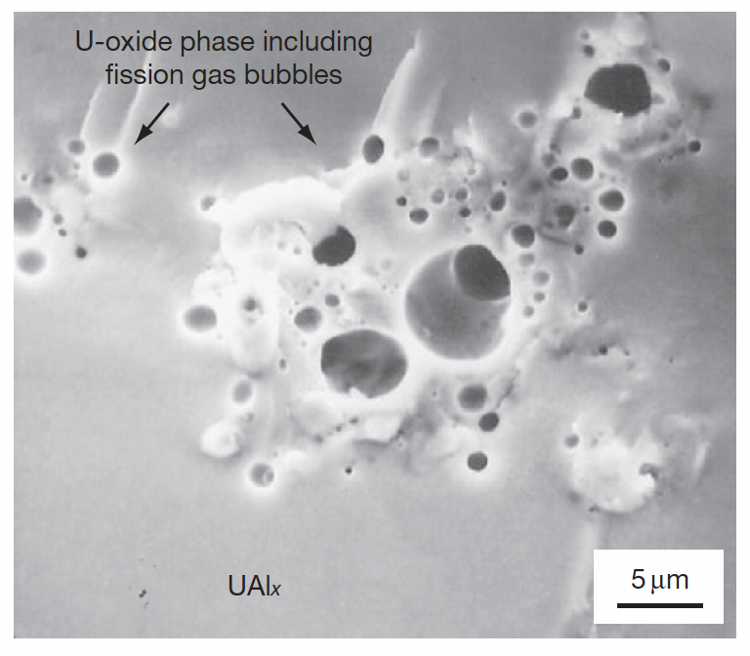
Fuel Swelling
Gaseous FP swelling is due to the formation of fission gas bubbles and is more difficult to quantify
Historical examinations on UAlx fuels showed no large fission gas bubbles in the fuel
Thus, fission gas bubbles were sufficiently small to be beyond the scope of 1980s-era SEM
However, oxide inclusions showed large fission gas bubbles
Oxides are present due to fabrication

Slide 27
Fuel Swelling
It is unclear whether the oxide clusters acted as reservoirs absorbing fission gas, or whether UAlx helps retard bubble formation
It is possible that nanoscale bubbles are forming, but are undetectable via SEM (I would argue this is necessary)
The gas bubble swelling is estimated by subtraction of solid fission product swelling from the total swelling of the plate

Slide 28
Amorphization
Fission gas mobility is also high in amorphous materials and the fuel material is more readily deformed by the growing gas bubbles
Thus, fission gas bubble growth in an amorphous material is faster/higher
The three U–Al intermetallics undergo amorphization depending on the fission rate and temperature
The lower the irradiation temperature and the higher the fission rate, the more readily the fuel becomes amorphous
The performance of all U intermetallic fuels is closely related to whether they are crystalline or amorphous during irradiation
The U intermetallic fuels tend to be amorphized by damage in the crystal structure caused by highly energetic fission fragments and low temperatures inhibiting recombination
Amorphization of a crystalline material is accompanied by an increase in volume, which facilitates atomic mobility, enhancing diffusion

Slide 29
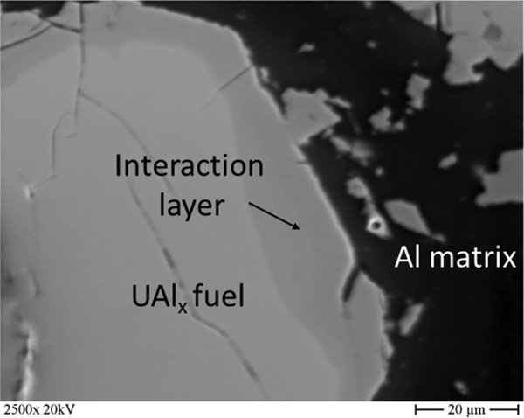
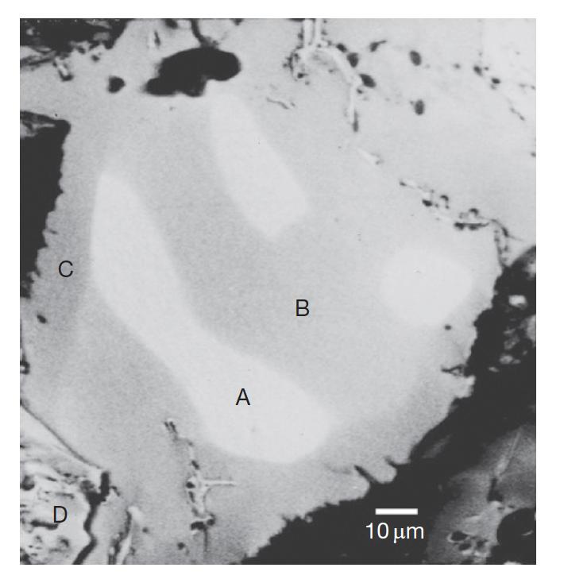
UAl-Al Interaction
UAlx and Al react during irradiation even at low temperatures due to irradiation-enhanced interdiffusion
UAl2 and UAl3 react with matrix Al to generate UAl4, and since there are no higher content compounds, UAl4 stays stable with Al
In the image, A is UAl2, B is UAl3, C is UAl4, and D is U oxide
Measured reaction data of UAlx–Al from in-pile tests are scarce

Slide 30
Fission Gas Bubbles
The fuel kernel and the interaction layers can both become amorphous
Even in the amorphous phases, no large fission gas bubbles have been observed in UAlx
Relatively recent TEM work has showed that at 20% burnup, Xe is still in solid solution in the amorphized phases
Conversion of UAl2 to UAl3 and UAl4 results in a volume reduction of the fuel, which generates extra space for fission products to reside, increasing the effective solubility
The high resistance of UAlx to large fission gas bubble formation and a higher as-fabricated porosity leads to a lower overall plate thickness increase in UAlx/Al compared to other fuel dispersion systems

